Slide 1

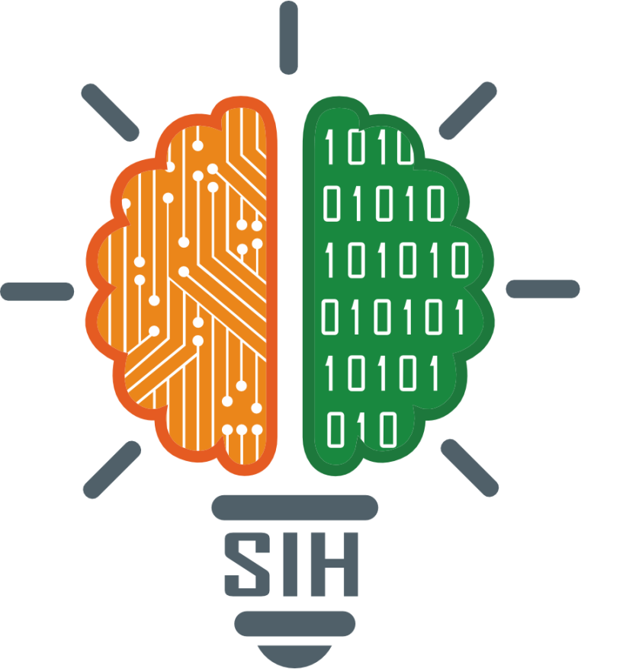
SMART INDIA HACKATHON 2025
Problem Statement ID – 25081
Problem Statement Title - AI-Driven Train Induction Planning & Scheduling for Kochi Metro Rail Limited
Theme – Smart Automation
PS Category- Software
Team ID -
Team Name (Registered on portal) : A STAR

Slide 2
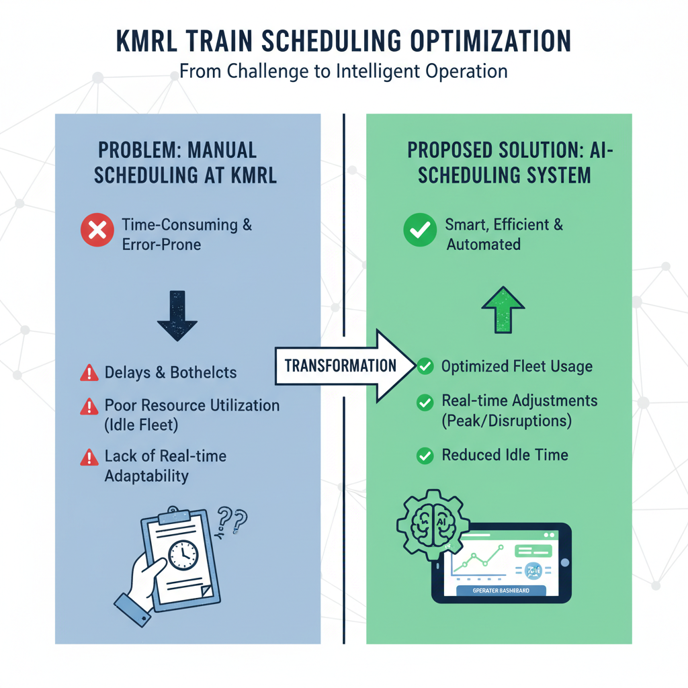
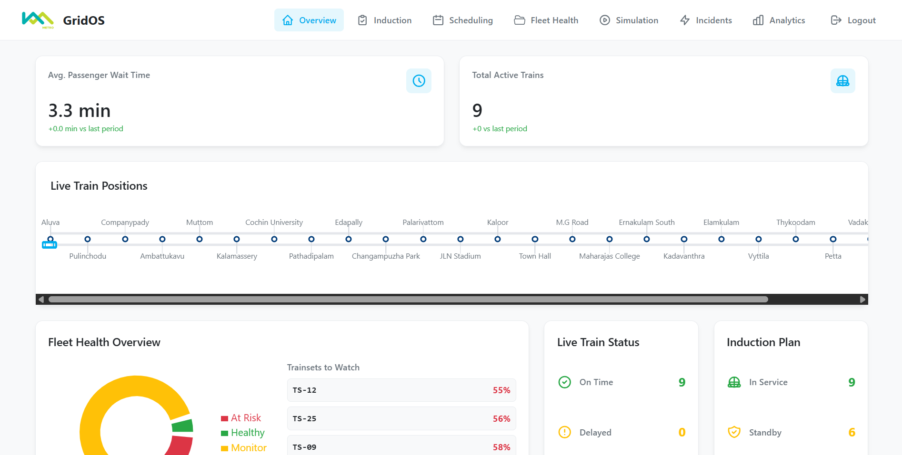
A star
\
A STAR
Delays & Bottlenecks
Unique Value Propositions (UVP):
Proactive & Predictive Disruption Management
Dynamic Fleet & Crew Optimization
Enhanced Service Resilience & Agility
Simplified Command with Actionable Intelligence
Grid OS PROTOTYPE

Slide 3
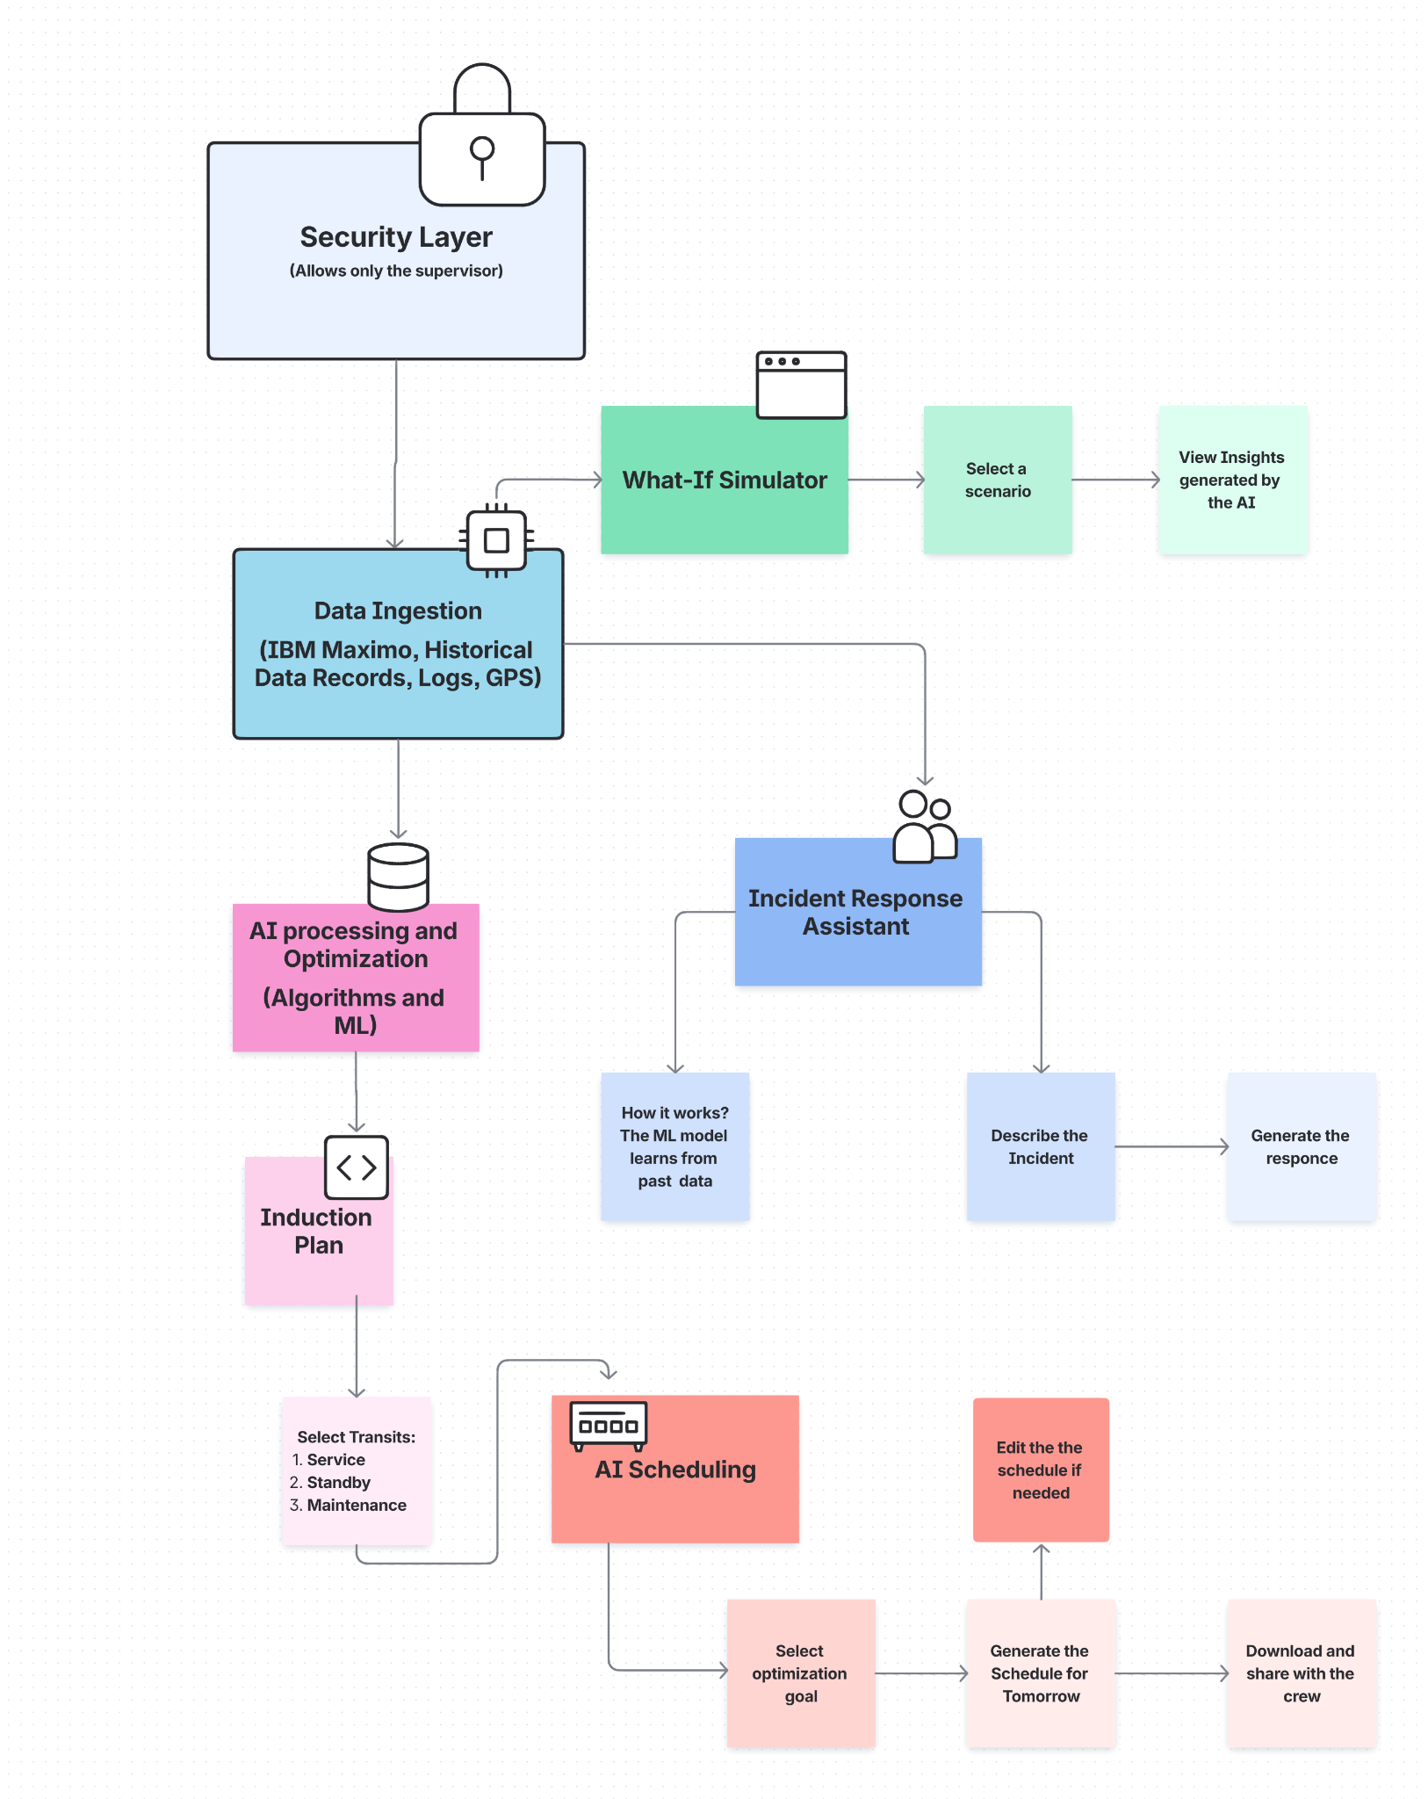




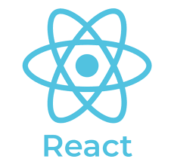

TECHNICAL APPROACH
A STAR
Technology Stack:
Backend & AI: Built with Python (Scikit-learn, OR-Tools) & Node.js, utilizing core algorithms like Genetic Algorithm and Dijkstra's.
Frontend: React/Typescript for the web dashboard.
Infrastructure & Security: Deployed on AWS/Azure/GCP with PostgreSQL/MySQL & S3 for storage. The system is secured using JWT and full data encryption.

Slide 4
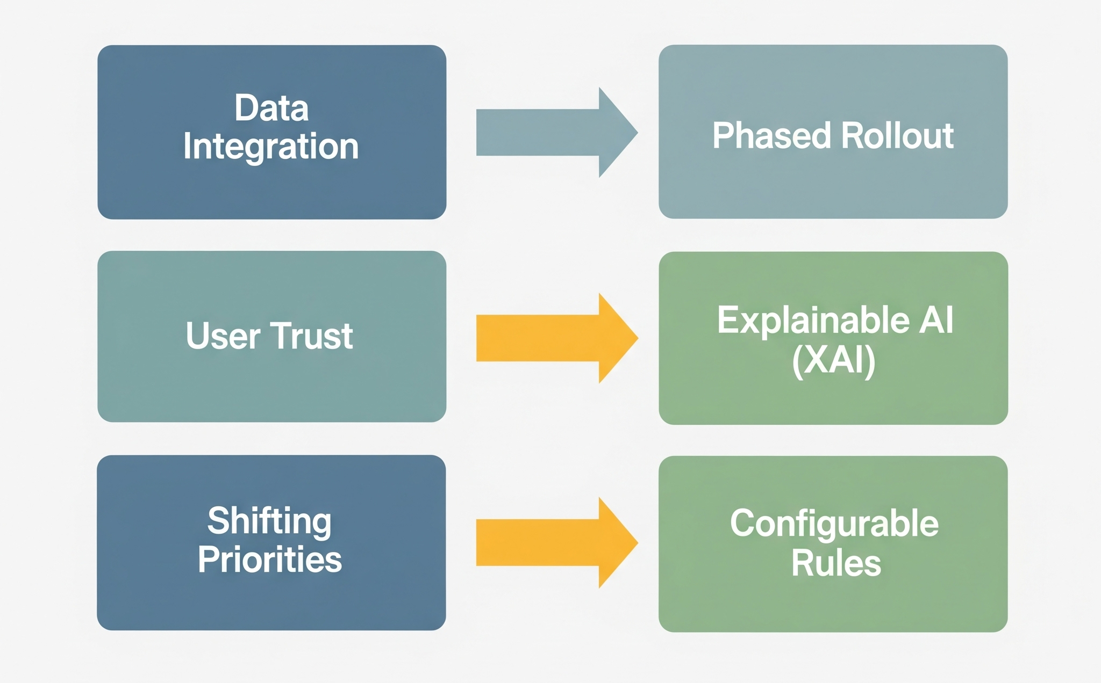
FEASIBILITY AND VIABILITY
A STAR
CHALLENGES
STRATEGIES
Is This Project Feasible? Yes.
Technical Feasibility: The solution relies on a mature and proven tech stack (Python, AI/ML libraries, modern web frameworks).
Uses open-source AI libraries + mock IoT feeds.
Scalable with low-cost cloud deployment.
Aligns with Digital India + Smart Mobility vision
Operational Feasibility: It's a Decision-Support Tool, not a replacement. The "human-in-the-loop" design keeps supervisors in control, ensuring smoother adoption.

Slide 5
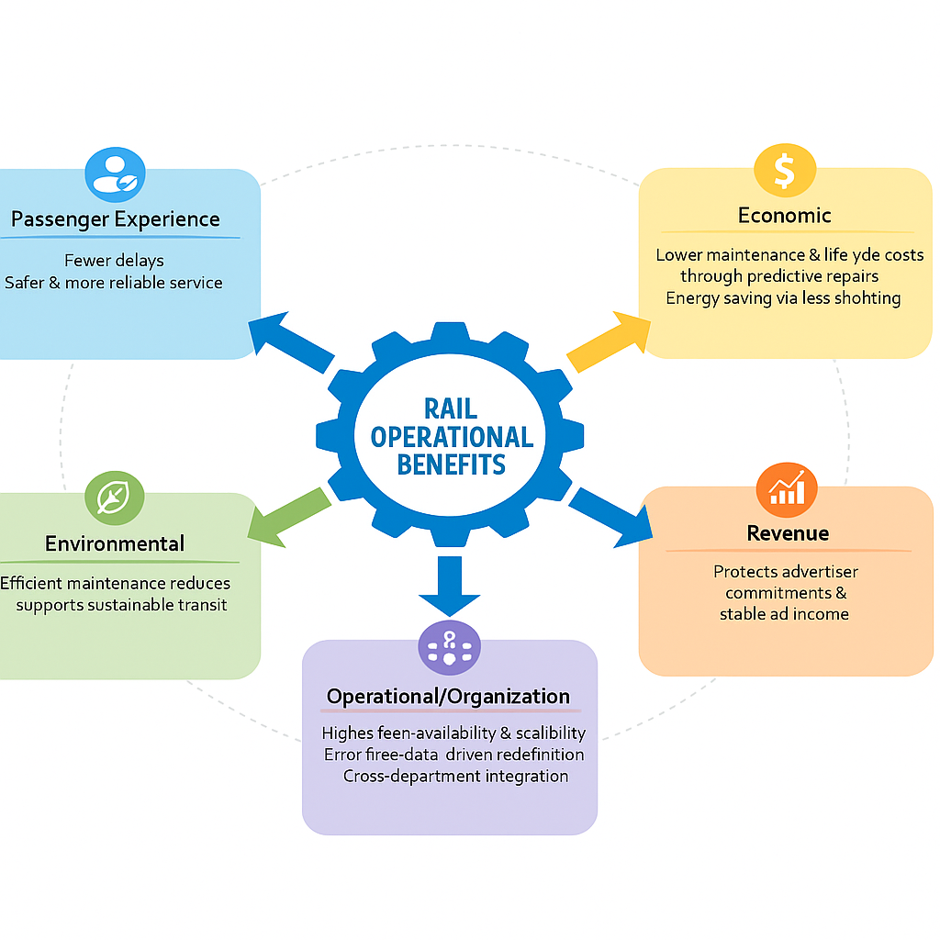
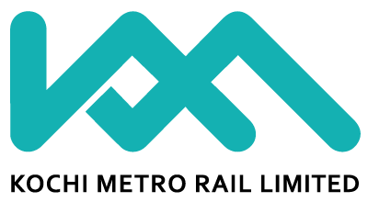
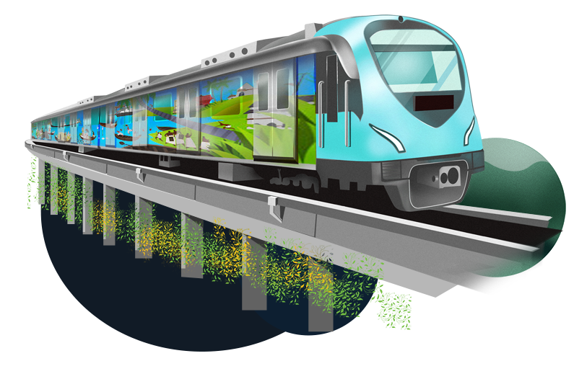
IMPACT AND BENEFITS
A STAR

Slide 6
RESEARCH AND REFERENCES
A STAR
Kochi Metro Rail Ltd. (KMRL) Annual Reports – Insights on operations, punctuality, and fleet expansion plans. https://kochimetro.org/annual-reports/
IBM Maximo Asset Management – Used by KMRL for maintenance/job cards. https://www.ibm.com/products/maximo
Indian Railways Standards & Guidelines – Safety and maintenance compliance (RDSO, Ministry of Railways). https://rdso.indianrailways.gov.in/
Kochi Metro Rail Lid. (KMRL) Train Timetable - Train timings data for the scheduling of the Transits.
https://kochimetro.org/train-time-table/
Feature | Existing Systems | Our AI Solution
Decision-Making | Manual & rule-based | Automated & optimized
Learning | No feedback, static | ML feedback loop, adaptive
Maintenance | Reactive checks | Predictive, IoT-driven
Revenue | Branding risk | AI ensures exposure
Transparency | Opaque decisions | Explainable & auditable

